Slide 1

Team 9 - Alzheimer’s Therapy
Bailey Brake, Ruohui Huang, Emily Lampat, Khang Le,
Yuri Zhang

Slide 2
Introduction and Problem Statement
Light Therapy
AlzLife
Light Attachment
Alzheimer’s and Dementia affect millions of americans each year. There is no cure, however, management of the cognitive decline seen in patients diagnosed with dementia plays a vital role in maintaining their quality of life.
Notes:
Alzheimer’s and Dementia affect millions of americans each year. There is no cure, however, management of the cognitive decline seen in patients diagnosed with dementia plays a vital role in maintaining their quality of life. Though there is no known cure, researchers continue to look into maintaining cognition of patients and managing symptoms. AlzLife has developed an application that flashes the users screen while they play cognitive games.

Slide 3
Requirements and Deliverables
Flash at 40Hz
Light intensity is visible to user
Adjustable light intensity
Attach to smartphone
Intuitive for user
Subtle & ergonomic electronics housing
Smartphone powered

Slide 4
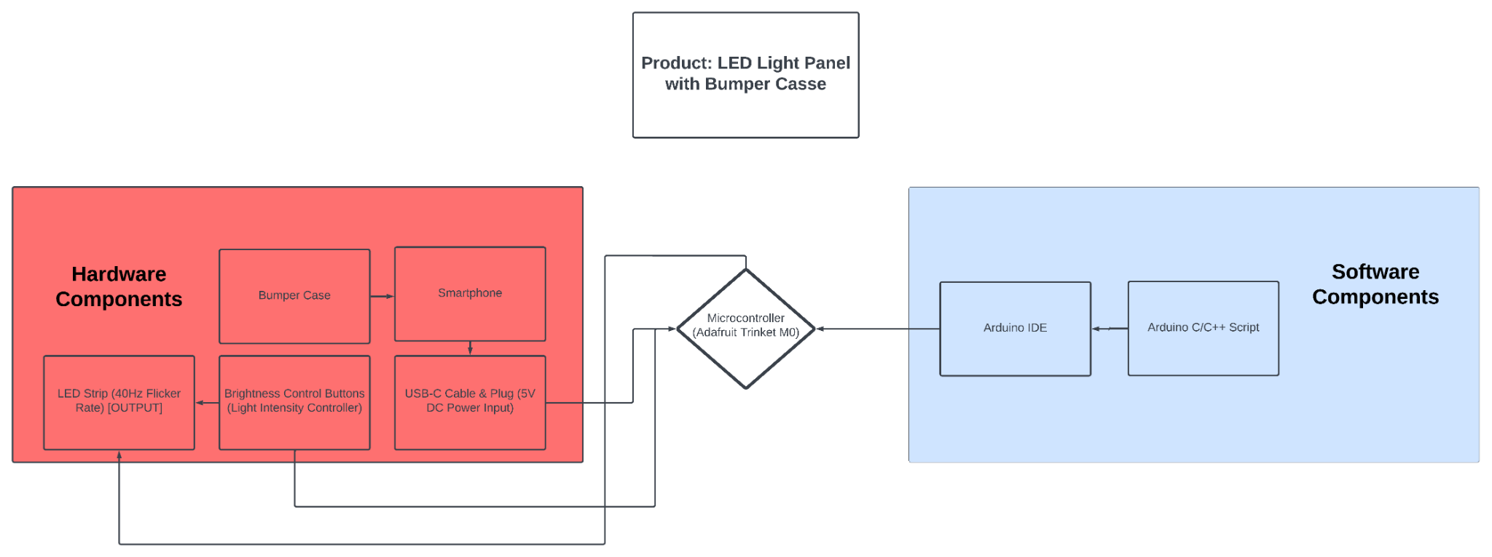
System Block Diagram

Slide 5
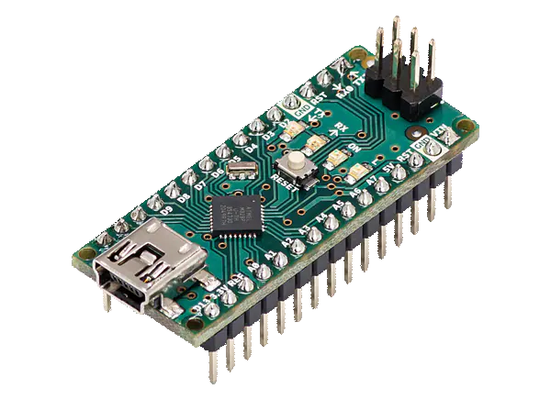
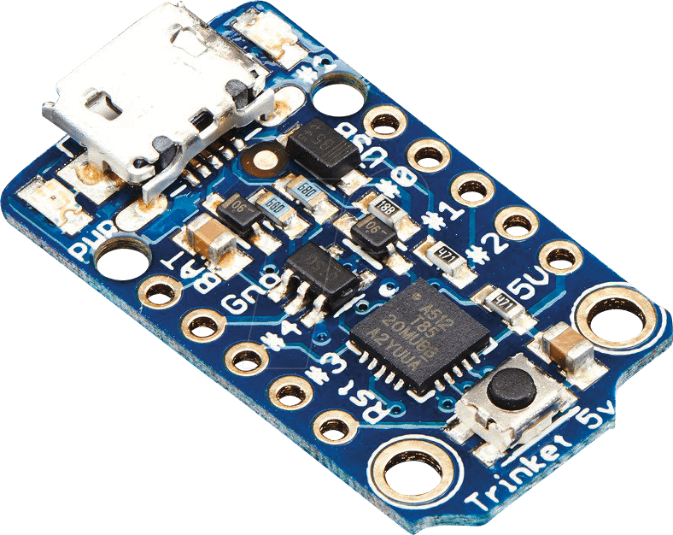
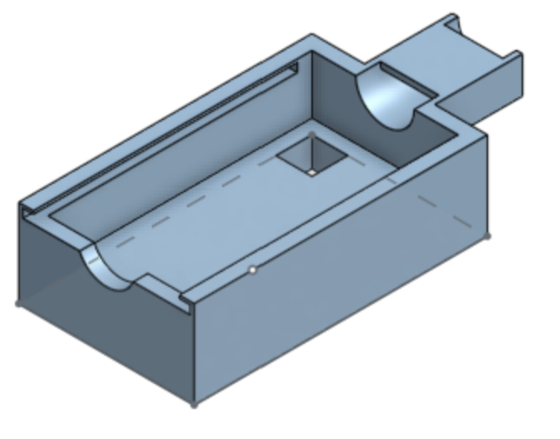
Hardware
Circuitry
Initial prototyping: Arduino Nano board
Upcoming prototype: Adafruit Trinket board
LED strip
Brightness control buttons
Housing
Current design: focus on compactness, then implement ergonomics

Slide 6
Software
Arduino Software (IDE)
Arduino programming language (based on C/C++)
Adjust LED brightness with two buttons.
Pins: LED (3), Increase Button (4), Decrease Button (5).
Blink Rate: 12.5ms intervals (40Hz).
Code Mechanics: Uses PWM for brightness, analogWrite for LED control.
Interaction: Press to increase/decrease brightness by 5, range 0-255.

Slide 7
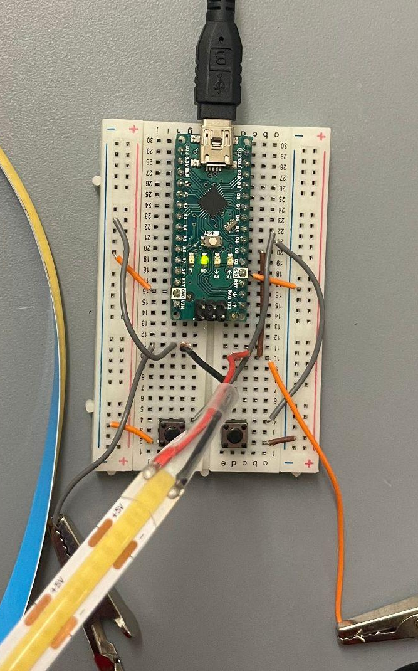
Testing procedure & results
Ensure Arduino is connected to a computer that has access to the code that generates PWM.
Compile and upload the script via the Arduino IDE.
Observe the oscilloscope and verify that the LED flickers within our desired time period.
Press the buttons to verify brightness is getting higher and lower corresponding to its own designated button, while maintaining the correct flicker frequency.
Circuit Setup

Slide 8
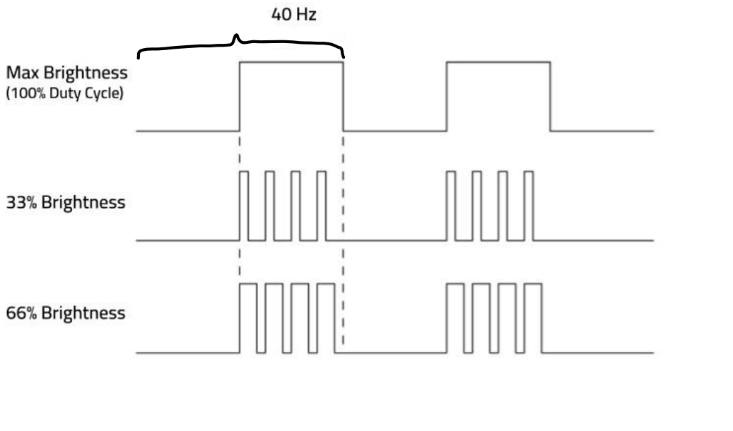
Testing procedure & results (Cont.)

Slide 9
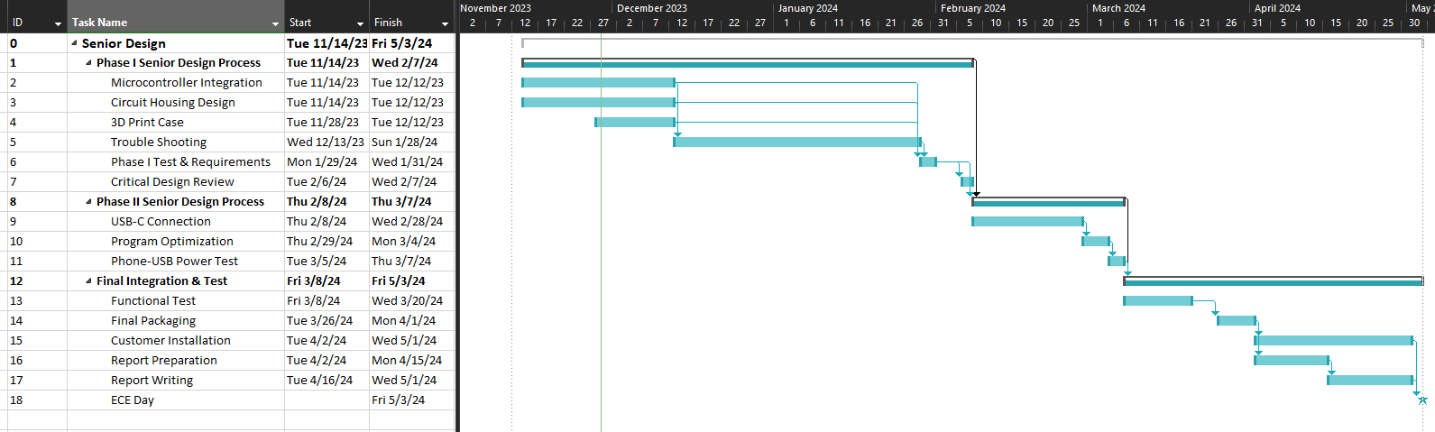
Schedule

Slide 10
Comments/Questions

